Slide 2
World Wide Energy is a Oil, Gas and Petrochemical industry
World wide energy is a Gas, Oil and Petrochemical industry offering various products and services extended to 5 branches worldwide. We deal with trading and supplying diverse oil and petroleum products. We have a stupendous industrial experience with an escalation of nearly 15 YEARS IN INTERNATIONAL TRADING. World wide energy offers a high quality of petroleum and oil products.

Slide 3
Services we offer
Supplying & Sourcing
Distribution & Logistics
Storage & Warehousing
we are specialised in supplying and Sourcing of different oil commodities from different countries.
Our distribution and logistics partners are vigorously involved known for efficiency and reaching the destination with a great team.
Over the years, Worldwide energy is strong in rendering the storage services for both suppliers and clients

Slide 4
Solutions & Capabilities
i. Provide quality products and services that source from reputed manufacturers.
ii. Become professional marketing partners to meet objectives of market information, sales and customer satisfaction
iii. Establish as a market leader in business segments.
iv. Strive to meet the demands of customers.
v. Become preferred suppliers to customers with our excellency in providing products and services.
vi. Give info to customers regarding trends of market developments and dynamics in the oil industry.
vii. Lessen the problems and develop transparency in trading, supplying and distribution.

Slide 5
Our Staff
We had skilled employees who can really capable of handling all the work commences in a daily basis.
We have total of 40 Employees

Slide 6
Exports
Urea PRILLED N46 UREA GRANULES N46 SULPHUR GRANULES BITUMEN DRUM AND BULK BASE OIL GYSPUM CEMENT
LIME STONE
SODA ASH DIESEL FUEL OIL PTA MEG LUBRICANTS LOW AROMATIC WHITE SPIRIT SOLVENTS

Slide 7
Clients

Slide 8
Testimonials
We are glad that we found a good supplier that meet our needs as well as a quick turn around time.
Working with WWE could be easy. Design, quotes and delivery are handled professionally and quickly. No matter how big the order was. This team make my life easy and had a great team experience that goes an extra mile in service.
Always they are quick to respond to orders. Care about keeping the customers happy, and the work is done on time.
Blitz International General Trading
Nova petrol turkey
Having dealt with WWE for many years, I’m satisfied with the services they provided. Very confident in placing the orders.
We are satisfied with the quality of job ensured by WWE team.
Chemco India
Petro Chem
Cape Refineries Pvt Ltd
Extremely happy for the concise and quick services, and I genuinely recommended WWE.
We are sharing our sincere thanks to the team for being so responsive and watchful.
Having dealt with WWE for many years, I’m satisfied with the services they provided. Very confident in placing the orders.
Palladin power assets Ltd
Al Suhail petro chemicals
Cape Refineries Pvt Ltd

Slide 9
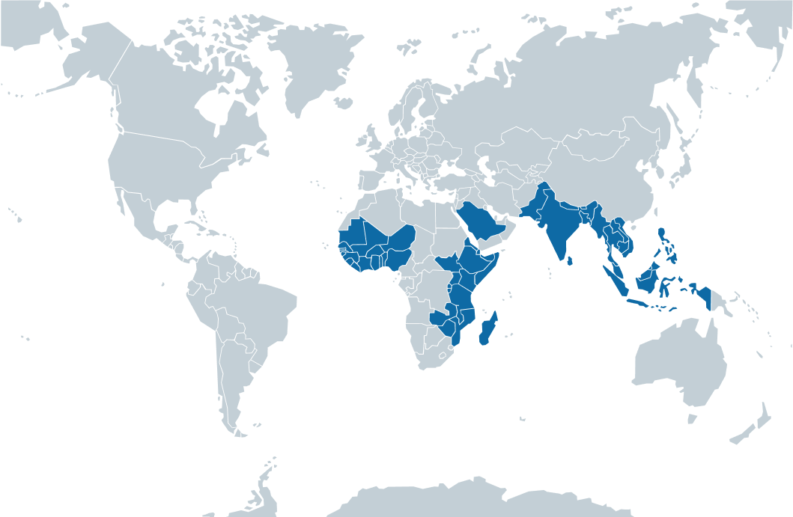
Our Locations & Our Branches

Slide 10
Contact us
Dubai, United Arab Emirates
+971 58 298 8856
+971 58 298 8856
info@worldwideenergyoil.com

